Slide 1
Concepts of Biology Biol 111 Minot State University
Lecture, MWF 12:00-12:50 pm
Cyril Moore Science Center, Room 16
Lab, Tuesdays/Thursdays
Swain Hall, Room 304

Slide 2
Lecture 31 April 23, 2018
Announcements—
Will get Exam 4 back in lab next week. We will go over them next Friday after they are returned.
This week’s lab---an evolution board game. You choose your traits. Amazingly fun and helps us understand natural selection!

Slide 3
Where were we?...
What is semiconservative replication?
How is DNA used in cells? How is the recipe for traits “read”?
What are the 2 parts of gene expression?

Slide 4
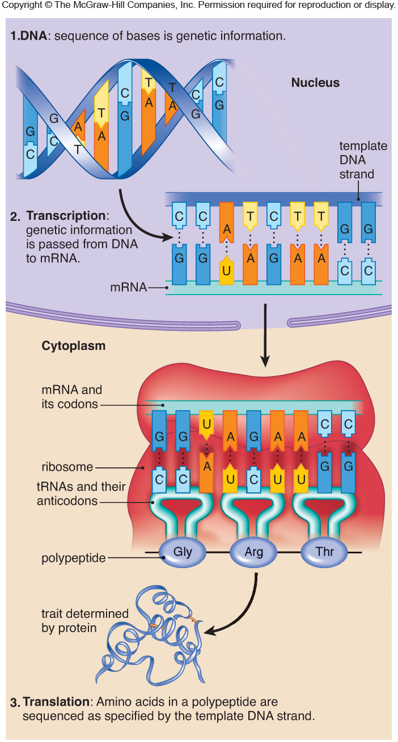
Fig. 11.9
Part 1---transcription. Making a complementary RNA sequence of the DNA sequence of a gene.
Transcription makes mRNA.

Slide 5
Gene expression—part 2
Gene expression is really a 2-part process.
2. The mRNA produced in transcription is translated into a protein.
Recall a protein is a sequence of amino acids.
Translation is converting the “language” of mRNA into the ”language” of amino acids to build a protein.

Slide 6
Cells use a system of 3-nucleotides for each amino acid.
This is called the genetic code. It is referred to as a triplet code.
Each 30 nucleotide code is called a codon.

Slide 7
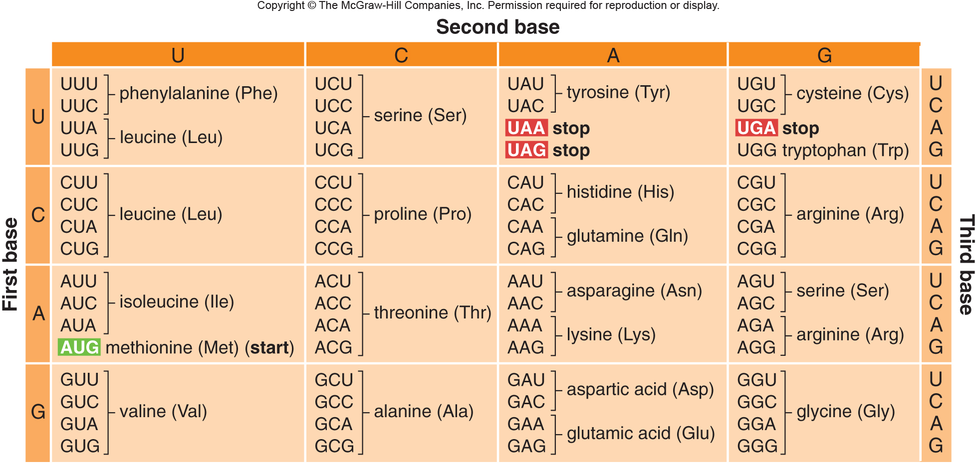
The universal genetic code

Slide 8
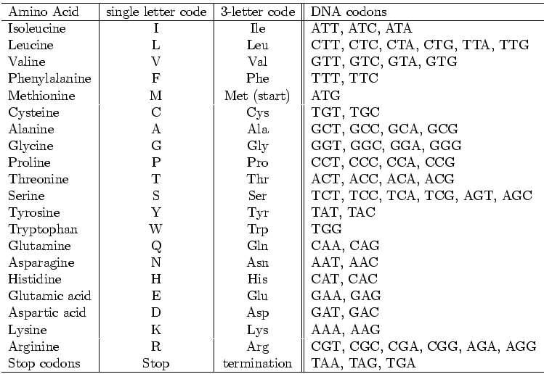
Most genetic code tables use the 3-letter abbreviation for the 20 amino acids

Slide 9
Note that the mRNA can be longer than is needed for the protein produced. Protein synthesis always begins at a specific codon, however.
The codon (AUG) is called the start codon. It codes for the amino acid, methionine.

Slide 10
Likewise, within the mRNA is a particular codon that signals the end of the protein has been reached.
We call this the stop codon. There are 3 different stop codons, UAA, UAG, UGA.
The stop codons don’t code for any amino acids but simply mark where translation should stop.

Slide 11
CACUUUCACGGGCUAUGUCGCUUCAAGAAGCAGCAACAUAACCGGGCAGGAGCU

Slide 12
Now let’s decode or translate the mRNA you transcribed earlier!
AUG/UCG/CUU/CAA/GAA/GCA/GCA/ACA/UAA
met- ser- leu- gln- glu- ala- ala- thr
24 nucleotides in the mRNA reading frame=8 amino acids in the protein. A small protein (like the one shown) is also called a peptide.

Slide 13
Why “universal”?
The genetic code is known as universal because the same code is used by all organisms to make proteins.
Viruses
Monkeys
Jellyfish
Bacteria
You name it!!

Slide 14
Where do the helper RNAs come into play?
rRNA makes up part of the ribosome
tRNA delivers the amino acids according to the mRNA code

Slide 15
Fig. 11.9
tRNAs have an RNA sequence that is complementary to each codon. They also have a specific amino acid attached to them.

Slide 16
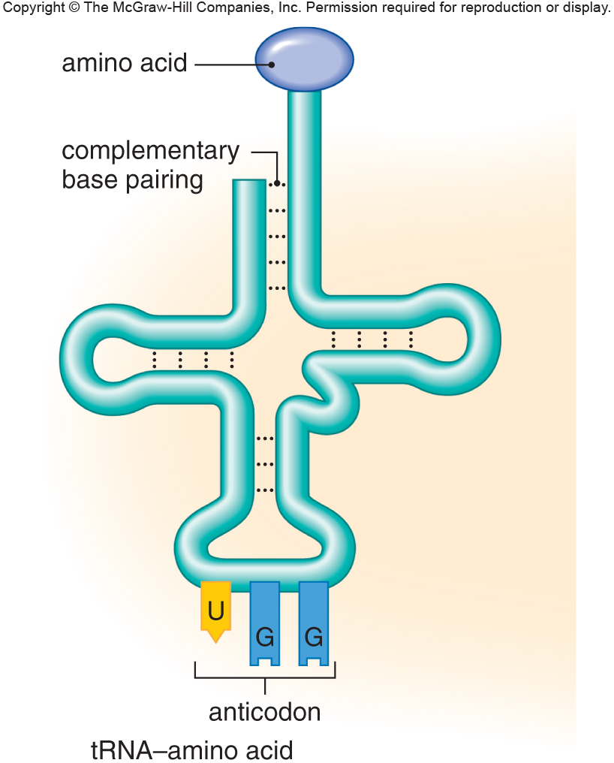
Fig. 11.13a

Slide 17
We won’t focus on more details of translation…please read and look at figures.
Review the cell---Now you can SEE what ribosomes do. Now you can SEE the rough ER’s role in the cell!
There are only minor differences in gene expression in prokaryotes and eukaryotes.

Slide 18
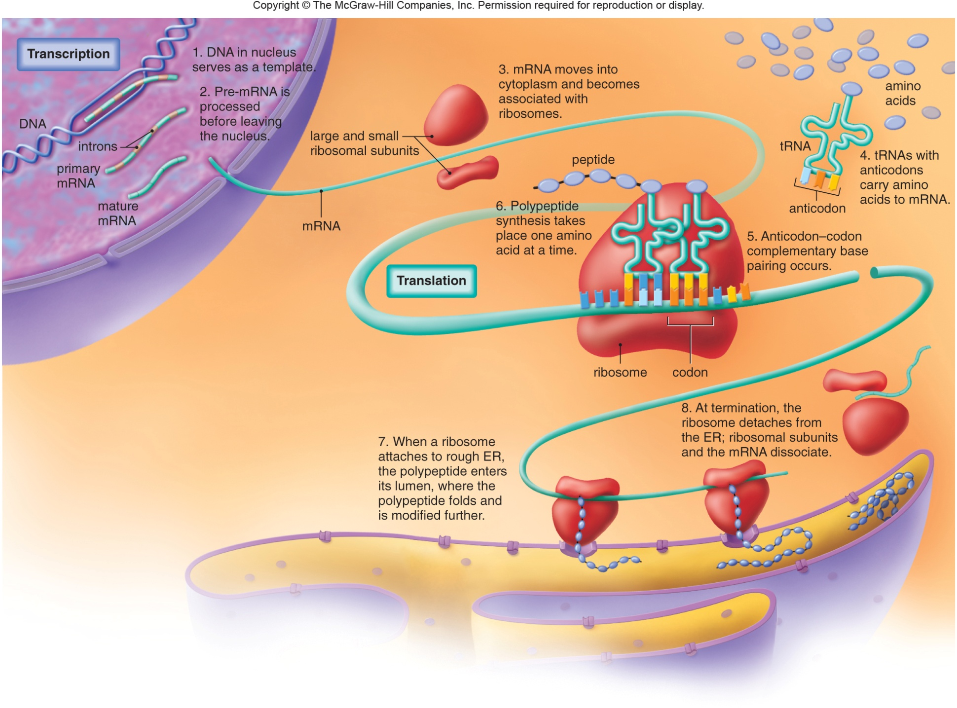

Slide 19
We do need to think about one more predicted characteristic of the genetic material.
It can change gradually over time. If a gene changes in anyway…predict the result….

Slide 20
A change in amino acids, which means a change in the protein!
And if proteins are ultimately what controls what a cell/organism can do…this protein change will likely introduce variation in the organism!

Slide 21
Let’s back up…
A change in DNA is known as a mutation. Once a nucleotide sequence change occurs in DNA, it is faithfully copied. It becomes permanent in all cells that were produced after the time of the mutation.

Slide 22
So let’s return to a familiar example…Mendel’s peas.
It is likely that at one time, all garden pea plants made smooth peas. By accident (probably during DNA replication), a change was made in a specific pea plant gene that resulted in wrinkly peas.

Slide 23
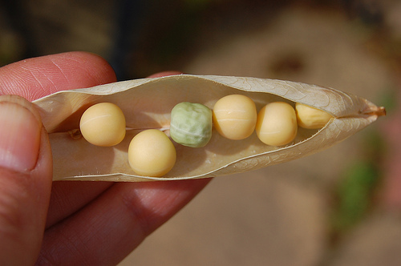

Slide 24
What makes one pea smooth and another wrinkled?
A different version of the same protein.

Slide 25
For example…consider the following… Pretend this little gene controls pea shape
AUG/UCG/CUU/CAA/GAA/GCA/GCA/ACA/UAA
met- ser- leu- gln- glu- ala- ala- thr
What if a mutation occurred here?
A substitution of one nucleotide for another is known as a point mutation. Other types of DNA changes occur---stay tuned.

Slide 26
AUG/UCG/CUU/CAA/GAC/GCA/GCA/ACA/UAA
met- ser- leu- asp- glu- ala- ala- thr
The new amino acid sequence might make the protein different enough to produce the wrinkling we see.

Slide 27
Now there are 2 different versions of a gene that affects the shape of peas.
What do we call different versions of the same gene?
Alleles! Alleles encode different versions of the same protein, to produce variation among individuals in a population.

Slide 28
Some of you have blue (non-pigmented) eyes and some of you have pigmented eyes due to variation in one gene. The gene encodes a protein that controls the production of pigment in the eye!
Your book describes alleles using an example observed in corn kernels. These alleles arose due to a different kind of mutation (not a point mutation), but illustrate the same idea.

Slide 29
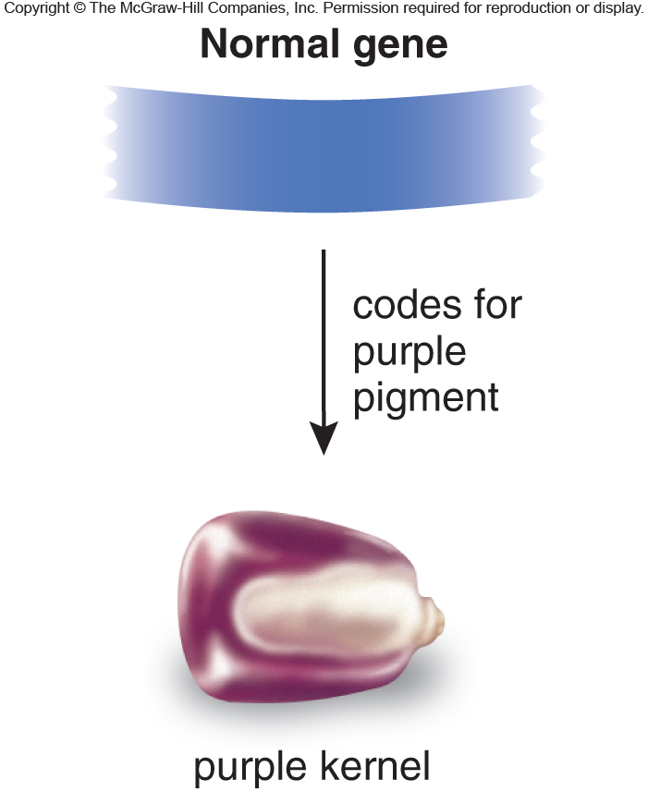
Fig. 11.18a

Slide 30
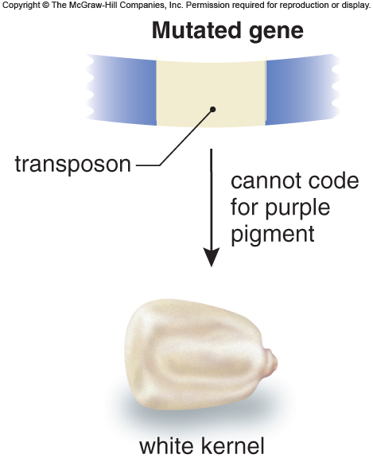
Fig. 11.18b

Slide 31
Connecting genetics to evolution
These small changes in genes provide variation in individuals in a population. Some variation may help these individuals survive. If they survive they potentially reproduce and pass that form of the trait to offspring…After time we may see populations shift and after a long time we may see creatures that resemble the original creatures, but have new/different traits…a different species.

Slide 33
Think about this mechanism of change when you play Evolution this week---
Think about the speckled moth example from last week---how did a little change in the coloration of moths lead to natural selection? A shift in what it looked like

Slide 34
Why is there resistance to evolution as a mechanism for biodiversity?
It is not consistent with a literal interpretation of immediate/rapid creation of different organisms by a higher power.
The human dilemma-- humans consider shared ancestors somehow demeaning---preferring a view of humans as higher/better form of life.

Slide 35
Overwhelming evidence…
Scientific dating of life/environments shows the earth and former life forms (fossils) at least millions of years old.
Direct analysis of DNA shows remarkably similar sequence of seemingly different life forms.

Slide 36
We share genes with bacteria and even viruses!

Slide 37
But we share more with mammals, especially primates
The next slides show variation in traits, but DNA analysis show the most direct evidence for shared ancestors.

Slide 38
Example?...
Over the last 2-3 million years, humans had small variations in skull shape.
Some variation was due to different alleles of genes controlling skull development or shape.
If a specific feature (like jaw shape) helped individuals to survive they reproduced and passed those alleles to their offspring.

Slide 39
Variation in skull design in humans

Slide 40
Modern humans evolved a larger brain space and less developed jaw.
Modern apes retain the jaw design to survive in their environment.

Slide 41
Modern Genetics
Since we know so much about how genes work---can we apply that information to change genes?
For example, could we change a gene alteration that causes a disease?
Can we control genes that give an organism a better chance of survival?
In some cases yes!

Slide 42
Biotechnology/Molecular Genetics
I started out discussing gene expression by saying that experiments from the 1950s through the 1980s really showed us how this all works.
Much research from the 1980s through today has focused on applying genetic mechanisms to benefit humans, and the living world.

Slide 43
Recall…the code is universal
That means any gene, from any organism, is expected to be expressed the same way in another organism.
We’ve taken advantage of this in the development of recombinant DNA technology.

Slide 44
Recombinant refers to the idea that we can cut and paste DNA from different organisms together AND that we put DNA from one organism into another.
We can recombine genetic material---human insulin can be made cheaply and efficiently by bacteria---people with type I diabetes use recombinant insulin.

Slide 45
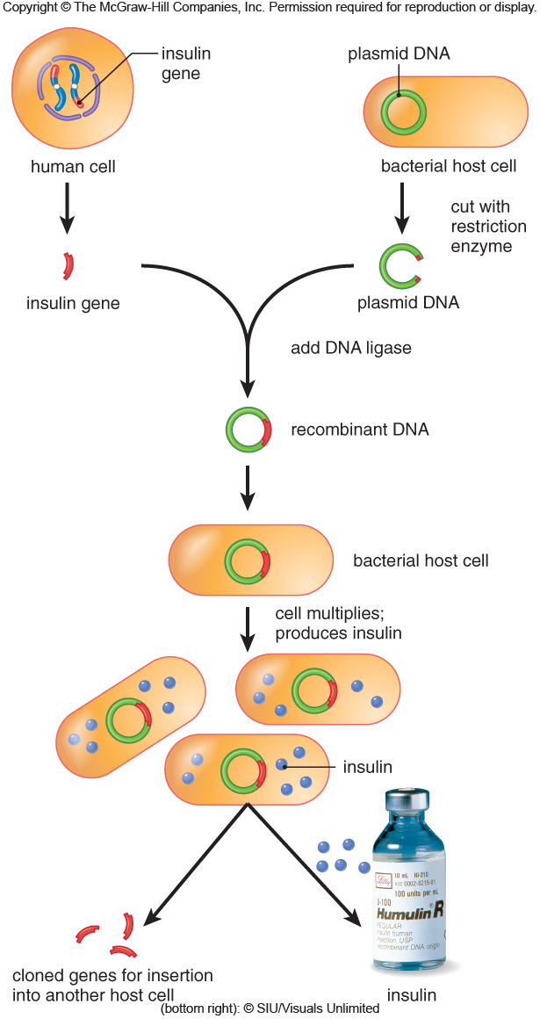
Fig. 11.19

Slide 46
Scientists have made modifications to organisms by adding genes to theirs.
When a gene from another organism is added, we call this a transgenic organism.

Slide 47
Examples?..
Bacteria with added genes to make them able to digest envronmental waste.
Fish with added growth genes make them bigger faster
Crop plants with added genes can withstand cold temps, weeds, or treatment with chemicals.

